Slide 1
Applications of AI and ML in real world
March 2, 2020
InLustro

Slide 2


Dinesh Kumar P
Product Manager,
Reports & Analytics Squad,
https://www.linkedin.com/in/dinesh-kumar-prabakaran
Notes:
Coming through 8+ years of journey around data space, I was deeply involved implementing B2B SaaS products for Big Data, ETL and Business Intelligence. Currently as a product manager, I take care of the analytics and reports squad at company called Kissflow. Here he would share his knowledge with his experience about his journey in data space and about the basics of AI and ML.

Slide 3

Agenda
My journey in Data Space.
Jobs around DATA.
Machine Learning and Artificial Intelligence in a general / layman language.
Evolution of No code/ Low code platforms for ML.
Demo using ML.Net Model Builder.

Slide 4

What quality / skill enables some people get a higher pay?
₹ 2,00,000
₹ 1,00,000
₹ 75,000
₹ 50,000
Notes:
Let me ask a simple question. For what basic skill, different people get different salary? Perhaps that is the same basic thing which all the ML or AI projects are solving and make our life easier.

Slide 5


Decision Making skill
Notes:
Its DECISION MAKING. And that’s what AI is doing for Humans right? I can say many real time examples for this. For now, lets take - the Google Maps. Before 5 years, if you are riding to a destination for which you don’t know the route, you will constantly ask the persons who are on your path way, think over the route and go on. But now, Google Maps in our mobile phone, decides and tells this is the right route. And we are travelling just by looking into that Map path. Notice that here decision making work is partially taken over by the software comparing to the same situation before 5 years.
Software are no more just software. As engineers, we are making them as intelligent agents and make them evolve as more human in nature. Simply say, future machines with software will slowly rise to the conscious level of humans even!

Slide 6
Every progress in a work Driven by decision making
Programmer decides,
If branch (or)
Switch statement
Business man decides,
More discount (or)
Kind words

Slide 7
My job journey around data
UG – Passionate about understanding data model. DFD and ER diagram.
PG – Build a POC by myself.
Big Data IDE product.
Big Data Cluster Manager product.
ETL product.
Business Intelligence product.
Analytics module of Kissflow.

Slide 8

Career around DATA
Can you plan the backend for this app / project? - Data Architect.
What kind of environment should I setup? – Big Data Admin / DataOps
How raw data should be processed to create prepared data via ETL? – Big Data Developer / Data Engineer
How to create best ML model by identifying combinations of prepared data and algorithms? – Data Scientist.
Summarize all these analysis as dashboard for decision makers. – Business Intelligence specialist.
Interpret the data, work alongside business teams understand needs and analyse results.
- Data Analyst
Notes:
I would like to call it as a Career than “JOB”

Slide 9
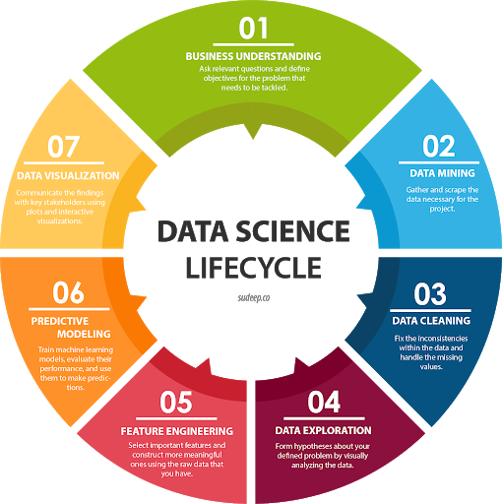
Data career landscape

Slide 10
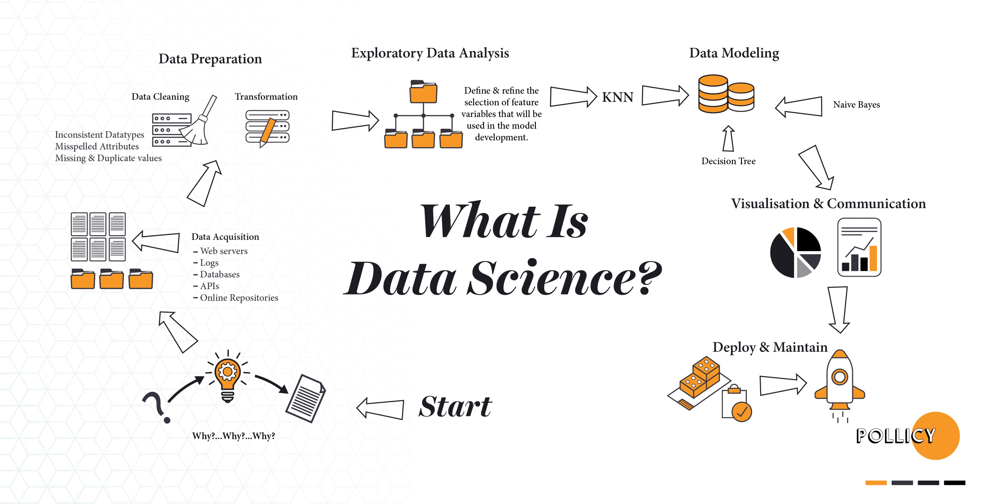

Slide 11
Primary skillset for any role in Data
SQL
Communication
Understand the Domain (Industry / Department)

Slide 12
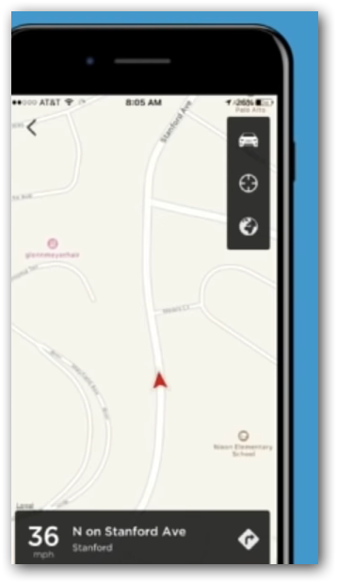
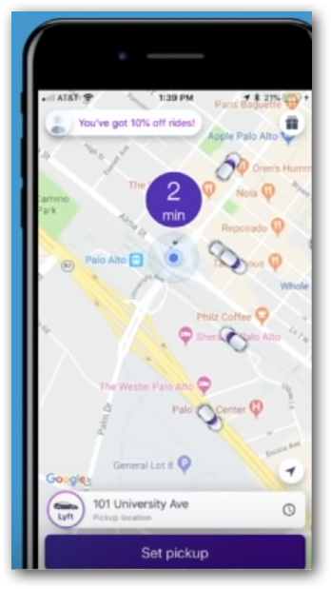
Why domain knowledge is important?
Where is my driver?
Just real time.
When will my driver get here?
Real time combined with historical data.
The Business (winning) touch.
Notes:
Data science – With the history of gbs or tbs of trip data, bring up some fact / model that can predict the approximate time
Big Data – Use that model in each and every trip and show the value to user. i.e. Real VALUE that a customer expect.

Slide 13
Features make humans different from machines
Taste,
Odour,
Thought,
Vision,
Speech,
Hear
Feel

Slide 14
Nowadays you can see these in Machines
Thought,
Vision,
Speech,
Hear
Notes:
Data Scientists and Machine Learning Engineers are working hard to recreate the sense of thought, hearing, speech and vision in machines. In the upcoming hour all we are going to see is around these features.

Slide 15
Examples

Slide 16
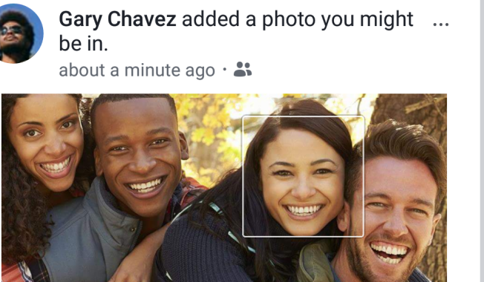
Thought
Facebook recognize faces like a human and suggests auto-tag while uploading a picture.

Slide 17
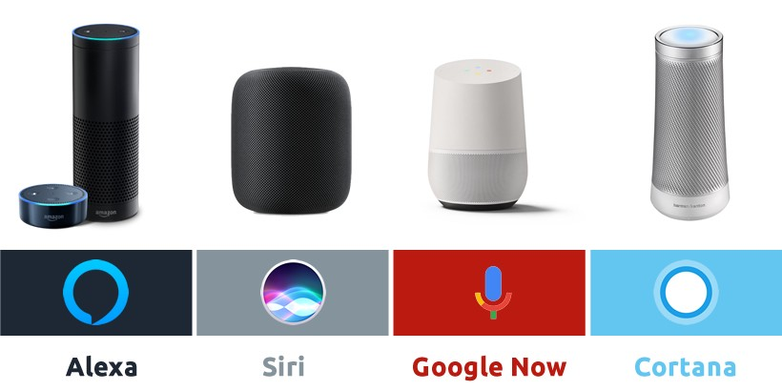
Hear & Respond
Google Assistant
Alexa
Siri
Notes:
Natural Language Processing

Slide 18
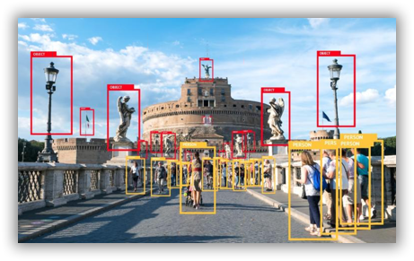
Vision
Surveillance
Capturing traffic violations

Slide 19
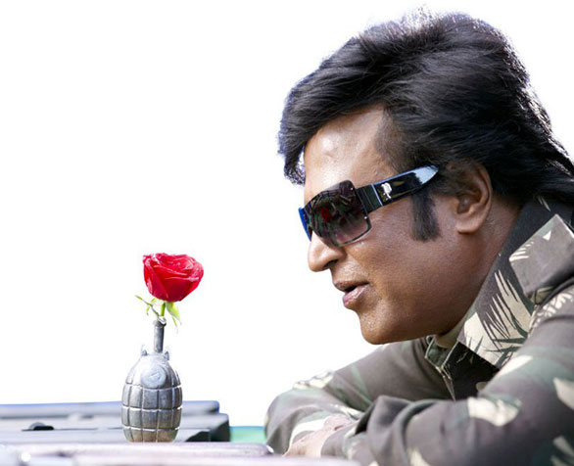

Feel

Slide 20
Human’s features into machines. WHY?

Slide 21
Machines match or overtake human intelligence?
Impossible actions like Rescue missions.
Accuracy – Consistent and Known level.
Speed.
Notes:
Machines match or overtake human intelligence.
- Rescue missions – Bore well, Mines.
-
- Consistent and Known Accuracy.

Slide 22
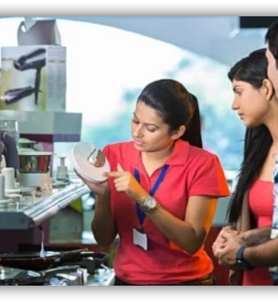
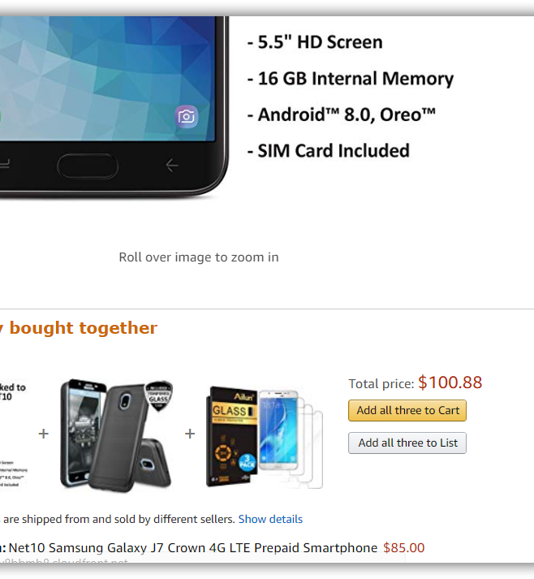
Notes:
Question:
The right side image - Where do you see such a thing?
Human may get tied. Vary in the process at times / situations. (Morning fresh, Evening tied)
Machines always perform as 100% until it is given the electricity power.

Slide 23
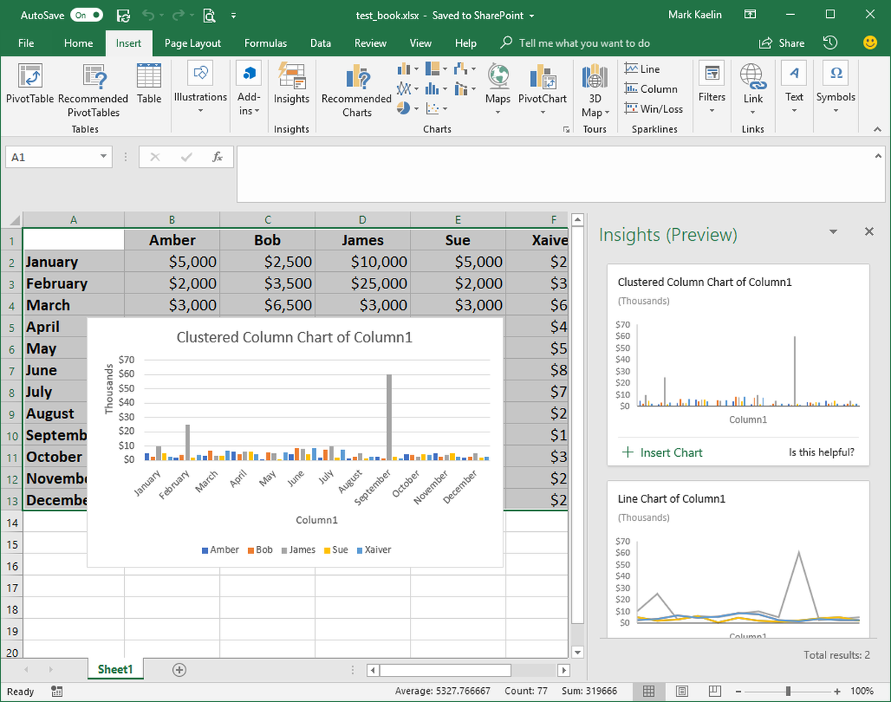
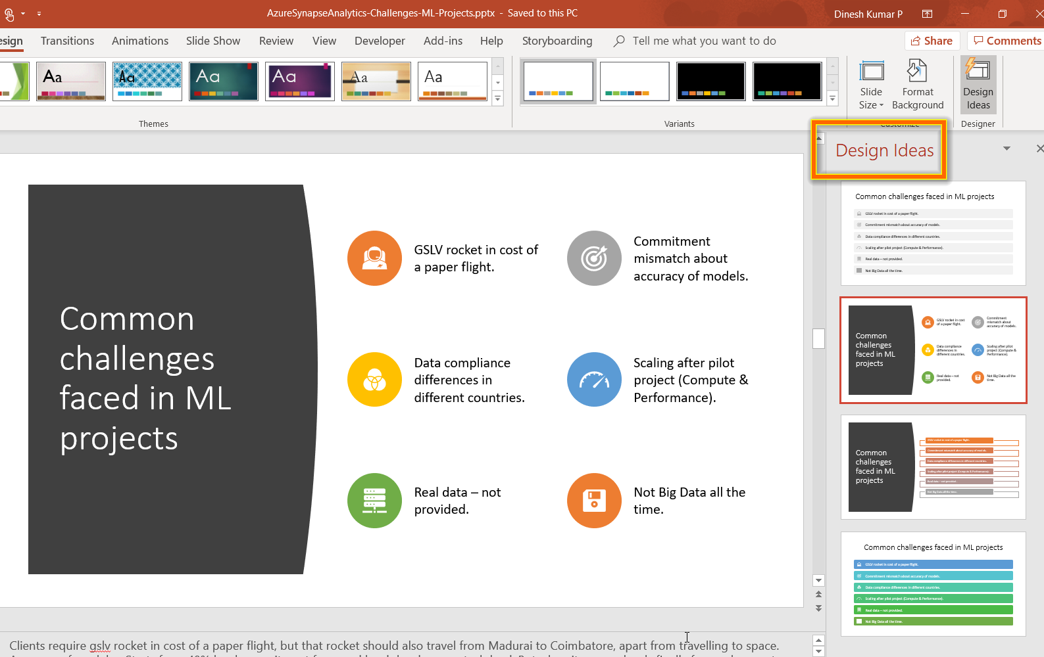
Excel
PowerPoint
Notes:
AI is everywhere. As you see in the slide,
‘Design Ideas’ in PowerPoint suggests you good designs and icon sets for the content, in a fraction of second than a human can think.
‘Ideas’ in Excel, automatically decides the suitable chart based on the data you have and populates it right inside of the Excel app automatically.
‘Insights’ in outlook lets you know, if anything you have promised is getting missed out without addressing it.

Slide 24

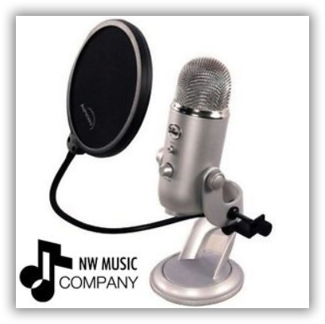
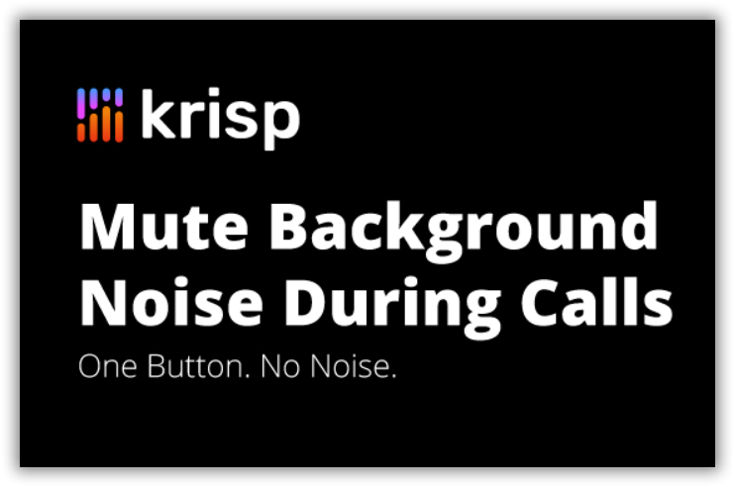
Machines match or overtake human intelligence?
BIAS against AI taking up jobs
Notes:
How many of you create YouTube videos here?
What do you do for recording a noise free video?
To record tutorial videos, in my own company we were evaluating multiple options. The left most – Sound proof room, Center – Noise cancelling MIC, Right – You could see a software that does all noise cancellation works.
Guess what we choose? It’s the noise cancelling software. It was way cheaper with our expected Quality. Now should I or my company think that did we make lose a job of a worker or a made loss for company who sell that MIC? Weird na?

Slide 25
Can you Answer?
Can you name one or both MS Office App and its AI feature?
Notes:
Powerpoint – Design ideas
Excel - Insights
Word – Auto spelling correct

Slide 26
Can you Answer?
4 features of humans nowadays we can see in machines?
Notes:
Thought, Vision, Speech, Hear

Slide 27
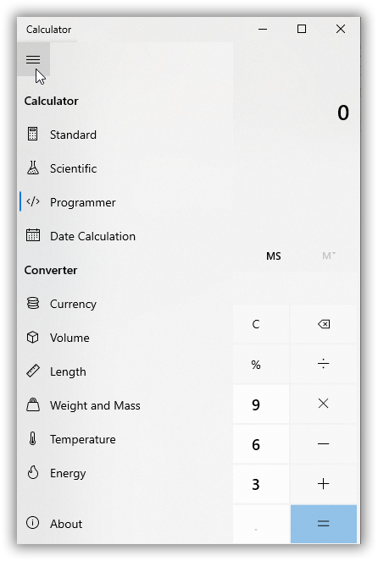
Notes:
Question:
Calculator has a lot of features. Its fast, efficient than most of the humans. So is this another example for Artificial Intelligence like previous chess game?
NO. Calculators do not have decision making abilities. So you cannot consider calculator as a AI device.

Slide 28

Notes:
Played HUMAN vs COMPUTER chess game? We Human will be efficient at times and not some times. But the opponent Computer wont get tied any number of times you play.
Is it AI? – Yes. It decides the move from a combination of different moves possible.

Slide 29
Can you Answer?
For what quality some people get a higher pay?
The same basic quality is that we try to incorporate into machines?
Notes:
DECISION MAKING

Slide 30
What is Machine Learning?
Artificial Intelligence
Machine Learning
Getting computers to make predictions without being explicitly programmed
Artificial Intelligence
The ability of a computer to perform tasks commonly associated with intelligent beings (reason, discover meaning, generalize, learn from past experience)
Deep Learning
Subset of ML based on artificial neural networks which imitate the way the human brain learns, thinks, and processes data.
Machine Learning
Deep
Learning
Notes:
AI = machines imitating human abilities and behaviors
Typically starts as rule or logic-based system
Traditional AI techniques can be difficult to scale
ML
Computers find patterns in data and learn from experience to act on new data
Used to solve problems that are difficult or impossible to solve with rules-based programming
Deep learning
Neural networks form many layers
Scenarios include image classification, object detection, speech recognition, NLP
AI: Rules + Data = Answers
Data + Answers = Rules

Slide 31
What is Machine Learning ?
A program that looks for patterns in existing data.
Recognize those pattern in new Data

Slide 32
What Machine Learning do?
Predicting future
Organizing or Grouping

Slide 33
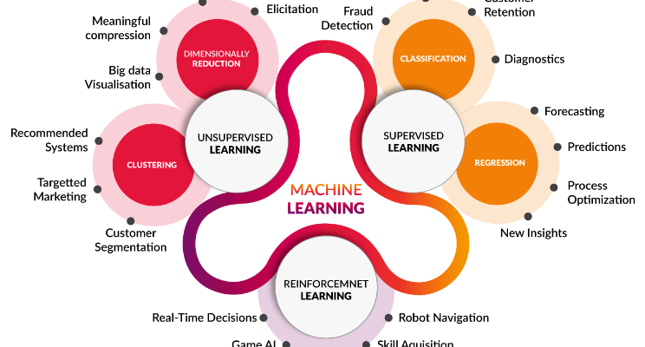
Algorithms

Slide 34
Five Questions to cover algorithms
1. Is this A or B ?
2. Is this Weird ?
3. How much effective or many ?
4. How this should be organized ?
5. What should I do next ?
Notes:
Classification.
Anomaly Detection.
Regression.
Clustering.
Reinforcement.

Slide 35
Mapping business problems to ML Tasks
What problem are you looking to solve?
Find outliers
Predict a number
Find relationships
Categorize items
Anomaly detection
Regression
Forecasting
Clustering
Binary classification
Multiclass classification
Make suggestions
Recommendation
Image classification
Phase 1.0
Notes:
Classification:
Categorize e-mail as spam or not spam
Automatically add labels to GitHub issues
Predict of sentiment of a comment is positive or negative
Diagnose if a patient has a disease or not
Categorize hotel reviews into location, price, cleanliness, etc.
Regression
Predict the price of a house based on house features
Predict sales of a product based on advertising budgets
Predict number of goals a player will scare in upcoming match based on previous perf
Recommendation
Recommend products to shoppers
Recommends movies or songs to users
Forecasting
Predict future sales based on past sales
Predictive maintenance
Weather forecasting
Product demand forecasting
Anomaly detection
Identify fraudulent transactions
Alert when there are predicted network intrusions
Find abnormal cluster of patients
Clustering
Customer segmentation
Ranking
Search results ranking

Slide 36
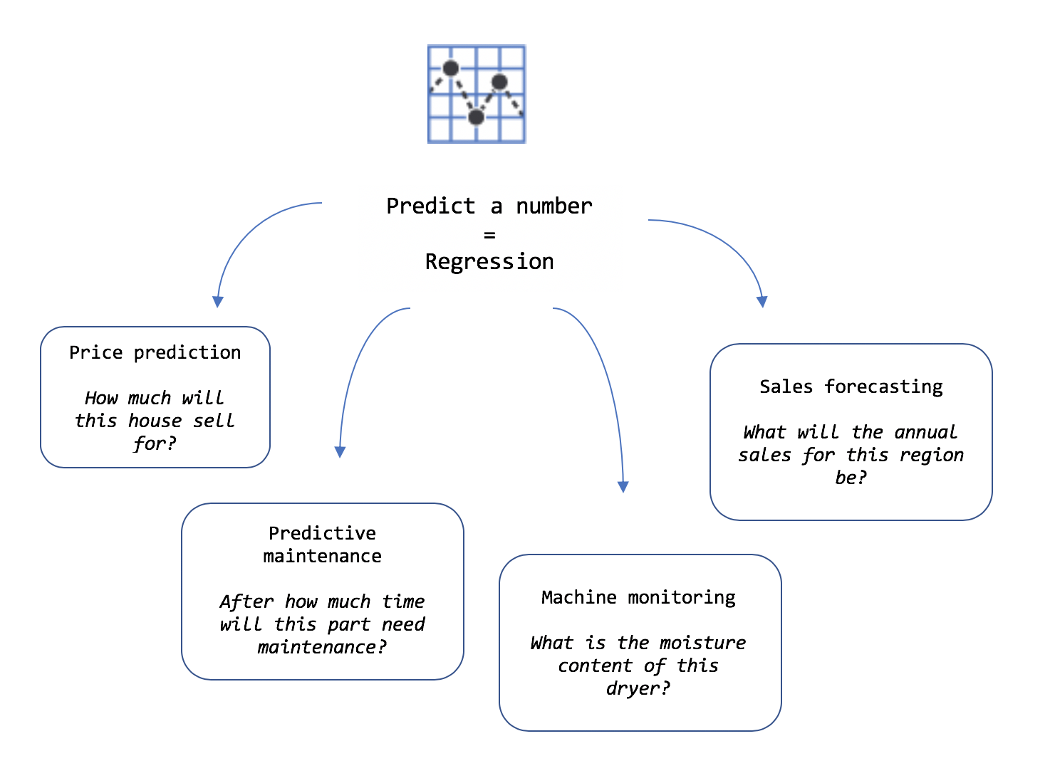
Clear about the requirement

Slide 37
Can you Answer?
ML Algorithm for this scenario.
Is this a cat or dog?
Notes:
Classification. Also, since there are only 2 options – Its Binary Classification

Slide 38
Can you Answer?
ML Algorithm for this scenario.
5 degree Temperature logged in Chennai on May, 1990
Notes:
Anomaly Detection

Slide 39
Can you Answer?
ML Algorithm for this scenario.
How much will this house sell for?
Notes:
Regression

Slide 40
Can you Answer?
ML Algorithm for this scenario.
What type of email is this?
Promotion or Personal or Social Media
Notes:
Clustering

Slide 41
Can you Answer?
ML Algorithm for this scenario.
Should I turn the car left or right?
Notes:
Reinforcement

Slide 42
If you know the problem well, figuring solution is as simple as it is.
Defining problem is 80%
Solution is just 20%

Slide 43
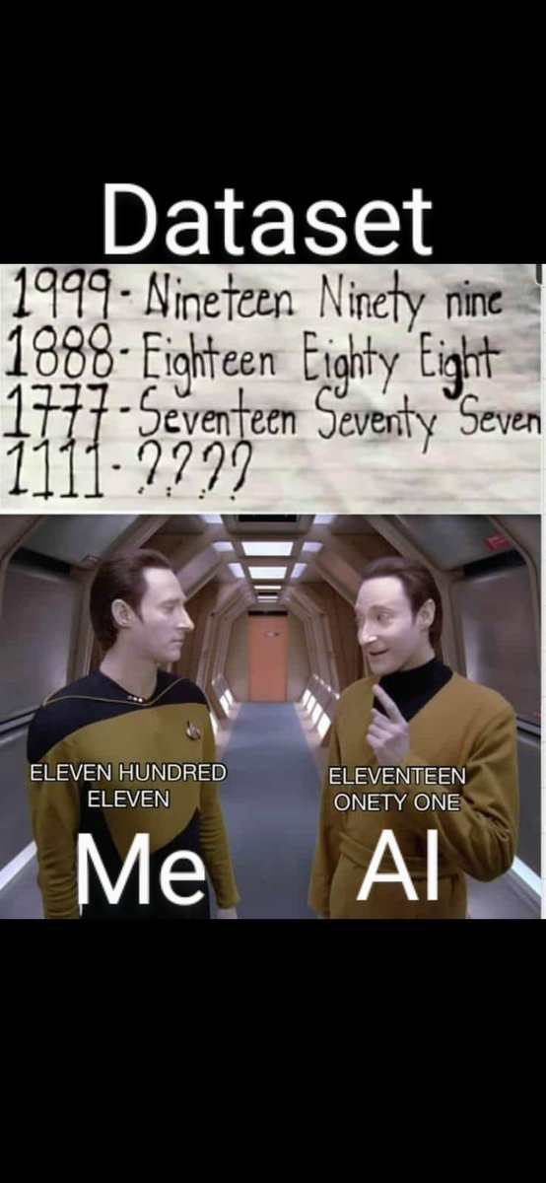
Just training alone enough? NO Correct Data is important than more data.

Slide 44
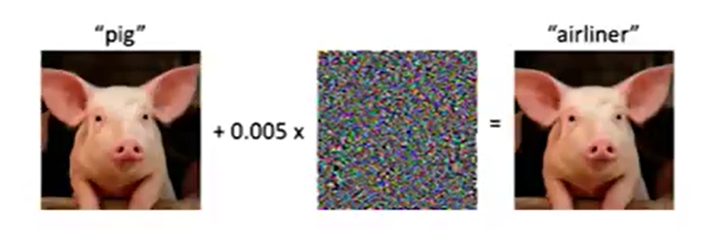
Trick an ML model Adversarial attack
Actual image and a broken image.
Looks same in human eye.
But a model will fail to recognize that both are same.

Slide 45
No/Low Code dev platforms
Problems better solvable by industry / business people like citizen data scientist.
DIY – Do It Yourself mindset.
Adobe Photoshop vs Canva.
Notes:
I hope you know tools like Canva. Such Tools are not so famous 10 years back. Late then, if any image editing work is needed, it was Photoshop and someone who learnt it very well is needed. But now, no code tool like Canva has made it possible to create a banner so easily. That's the case of ML.Net model builder as well. Currently the adoption to production environment is mostly on enterprise level. But in a while Machine Learning will become essential for any application.

Slide 46
Why no-code / low-code important for companies now?
Attain growth faster with small, lean & remote workforce.
Fail fast.
By the year 2024 65% of app development and 66% of companies would use 4 low-code tools & platforms.

Slide 47
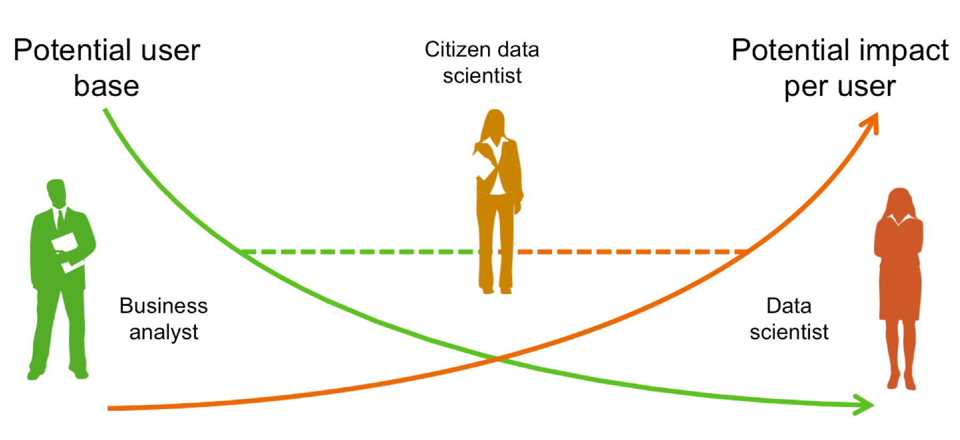
Democratization in Data Gaps are getting reduced
Notes:
Problem owners can drive the solution better and faster. The gaps will be reduced.

Slide 48
Machine Learning Model
A machine learning model is a file or think as a piece of software.
Trained to recognize certain types of patterns.
You train a model over a set of data, providing it an algorithm that it can use to reason over and learn from those data.

Slide 49
Pre-trained model vs prepare a ML model
Different businesses have different sense of data.
Specific problems relevant to individual business should be able to solve better by those business users.
Feedbacks of Movie, E-Commerce retail shopping website, Food ordering app may not be same type to categorize as good / bad.
Notes:
There are pre-trained models available that can be used in few button clicks.

Slide 50
Machine Learning for Developers
Rules
Classical Programming
Answers
Data
Data
Machine Learning
Answers
Rules

Slide 51
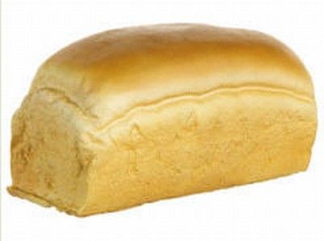

Classical Programming
if(profileImage) {
if(isRectangular) {
if(topIsRound) {
if(hasEars) {
return false;
}
else if (hasEyes) {
return false;
}
else {
return true;
}
}
}
}
Bread
or
not bread?
Insert a bunch of if-else statements here to show that not scalable – insert MACHINE LEARNING

Slide 52
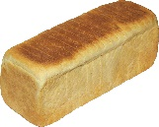
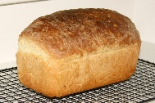
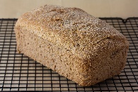
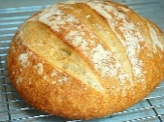
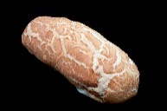



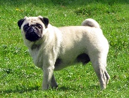



Machine Learning
Bread
Bread
or
not bread?
Not bread

Slide 53
ML.Net
Open source cross-platform machine learning framework.
Auto ML made easy to play via Model Builder with GUI.
Not required much expertise in ML.

Slide 54


What is ML.NET?
An open source and cross-platform machine learning framework for .NET
Windows
Linux
macOS
Notes:
History:
2002: MSR begins TMSN (“text mining search and navigation”) to enable internal devs to easily add custom ML to Microsoft products and technologies
2011: Library renamed to The Learning Code (TLC); widely used within Microsoft
2018: TLC is made open source, cross-platform, and released as ML.NET in first public preview at Build 2018
2019: ML.NET GA release at Build 2019
2020: Virtual ML.NET – first all ML.NET conference!

Slide 55






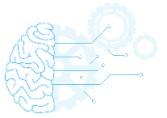

Machine Learning Landscape
External
At Microsoft
Azure Cognitive Services
Azure Machine Learning
WinML
 | Training custom models | Model consumption | Requires ML knowledge
ML.NET | Yes | Yes - ML.NET, TensorFlow, ONNX | No
Azure Cognitive Services | Limited to some services | Yes – consume via API/SDK | No
Azure ML | Yes | Yes – register models & consume via web service | Somewhat
WinML | No | Yes - ONNX | No
Notes:
scikit-learn – Traditional / Classical Machine Learning
TensorFlow – ML Deep Learning
PyTorch – ML Deep Learning
Keras – Open-source library that provides a Python interface for artificial neural networks. Higher level API for building ML that can use a variety of back-ends to actually build the models and computations; Keras acts as an interface for the TensorFlow library.
ONNX - An open format built to represent machine learning models allowing you to interchange models between various ML frameworks and tools. AI developers use models with a variety of frameworks, tools, runtimes, and compilers.

Slide 56
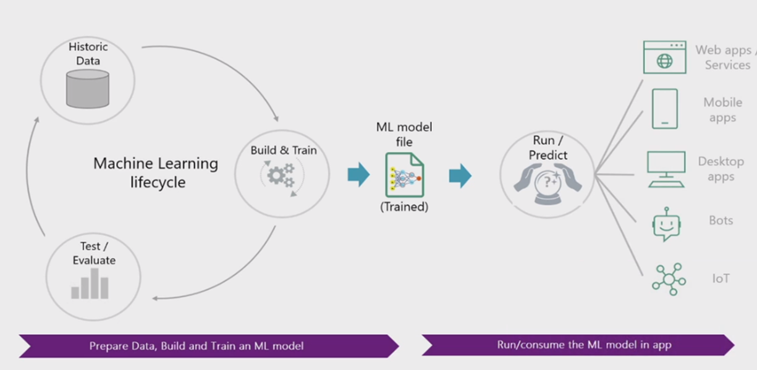
ML.Net
Notes:
Microsoft has decided to make Machine Learning accessible to .NET developers through ML.NET. ML.NET API is very simple and easy to learn. You can forget about large mathematical equations and implementations of algorithms.
Diagram show the process of building models using ML.NET.
1. Prepare your data. 2. Decide the algorithm to use. 3. Train a model using the selected algorithm. 4. Evaluate the model. 5. Save the model. 6. Use the saved model in your .NET applications.

Slide 57
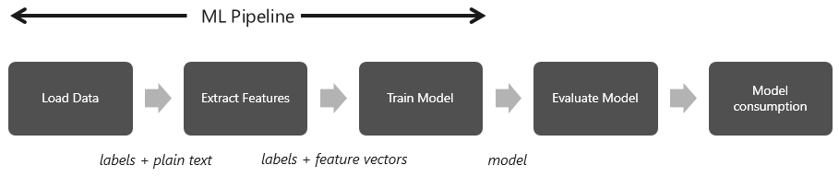
ML Pipeline Think as a water pipeline from river to your home

Slide 58
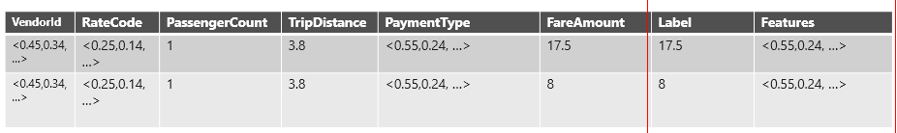
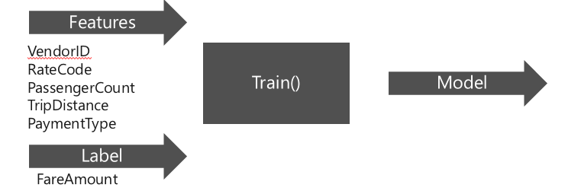
Features and Label(s) Uber’s taxi fare example
Notes:
Change the column names

Slide 59
My Use Case for ML.Net Model Builder
Goal: Recognize the sentiment of feedback text with 3 rating.
Reason: 1,2 rating mostly will have worst comment. Similarly 4,5 will have good comments. Feedbacks with 3 rating is annoying and yet to predict.

Slide 60
1. Train the model with same customer data with 1, 2, 4 and 5 ratings
2. Test the model
3. Use the model to check comments of 3 rating, where it fits in – 1, 2, 3 or 4
4. Pipeline to retrain the model in future

Slide 61
ML.Net Demo

Slide 62
Resources
Learning programming languages in Tamil – Python
Books
Cartoon Introduction to Statistics
Thinking Fast & Slow by Daniel Kaheman
Art of thinking clearly – Rolf Dobelli

Slide 63



Thank you! Questions?
https://www.linkedin.com/in/dinesh-kumar-prabakaran

